Slide 1

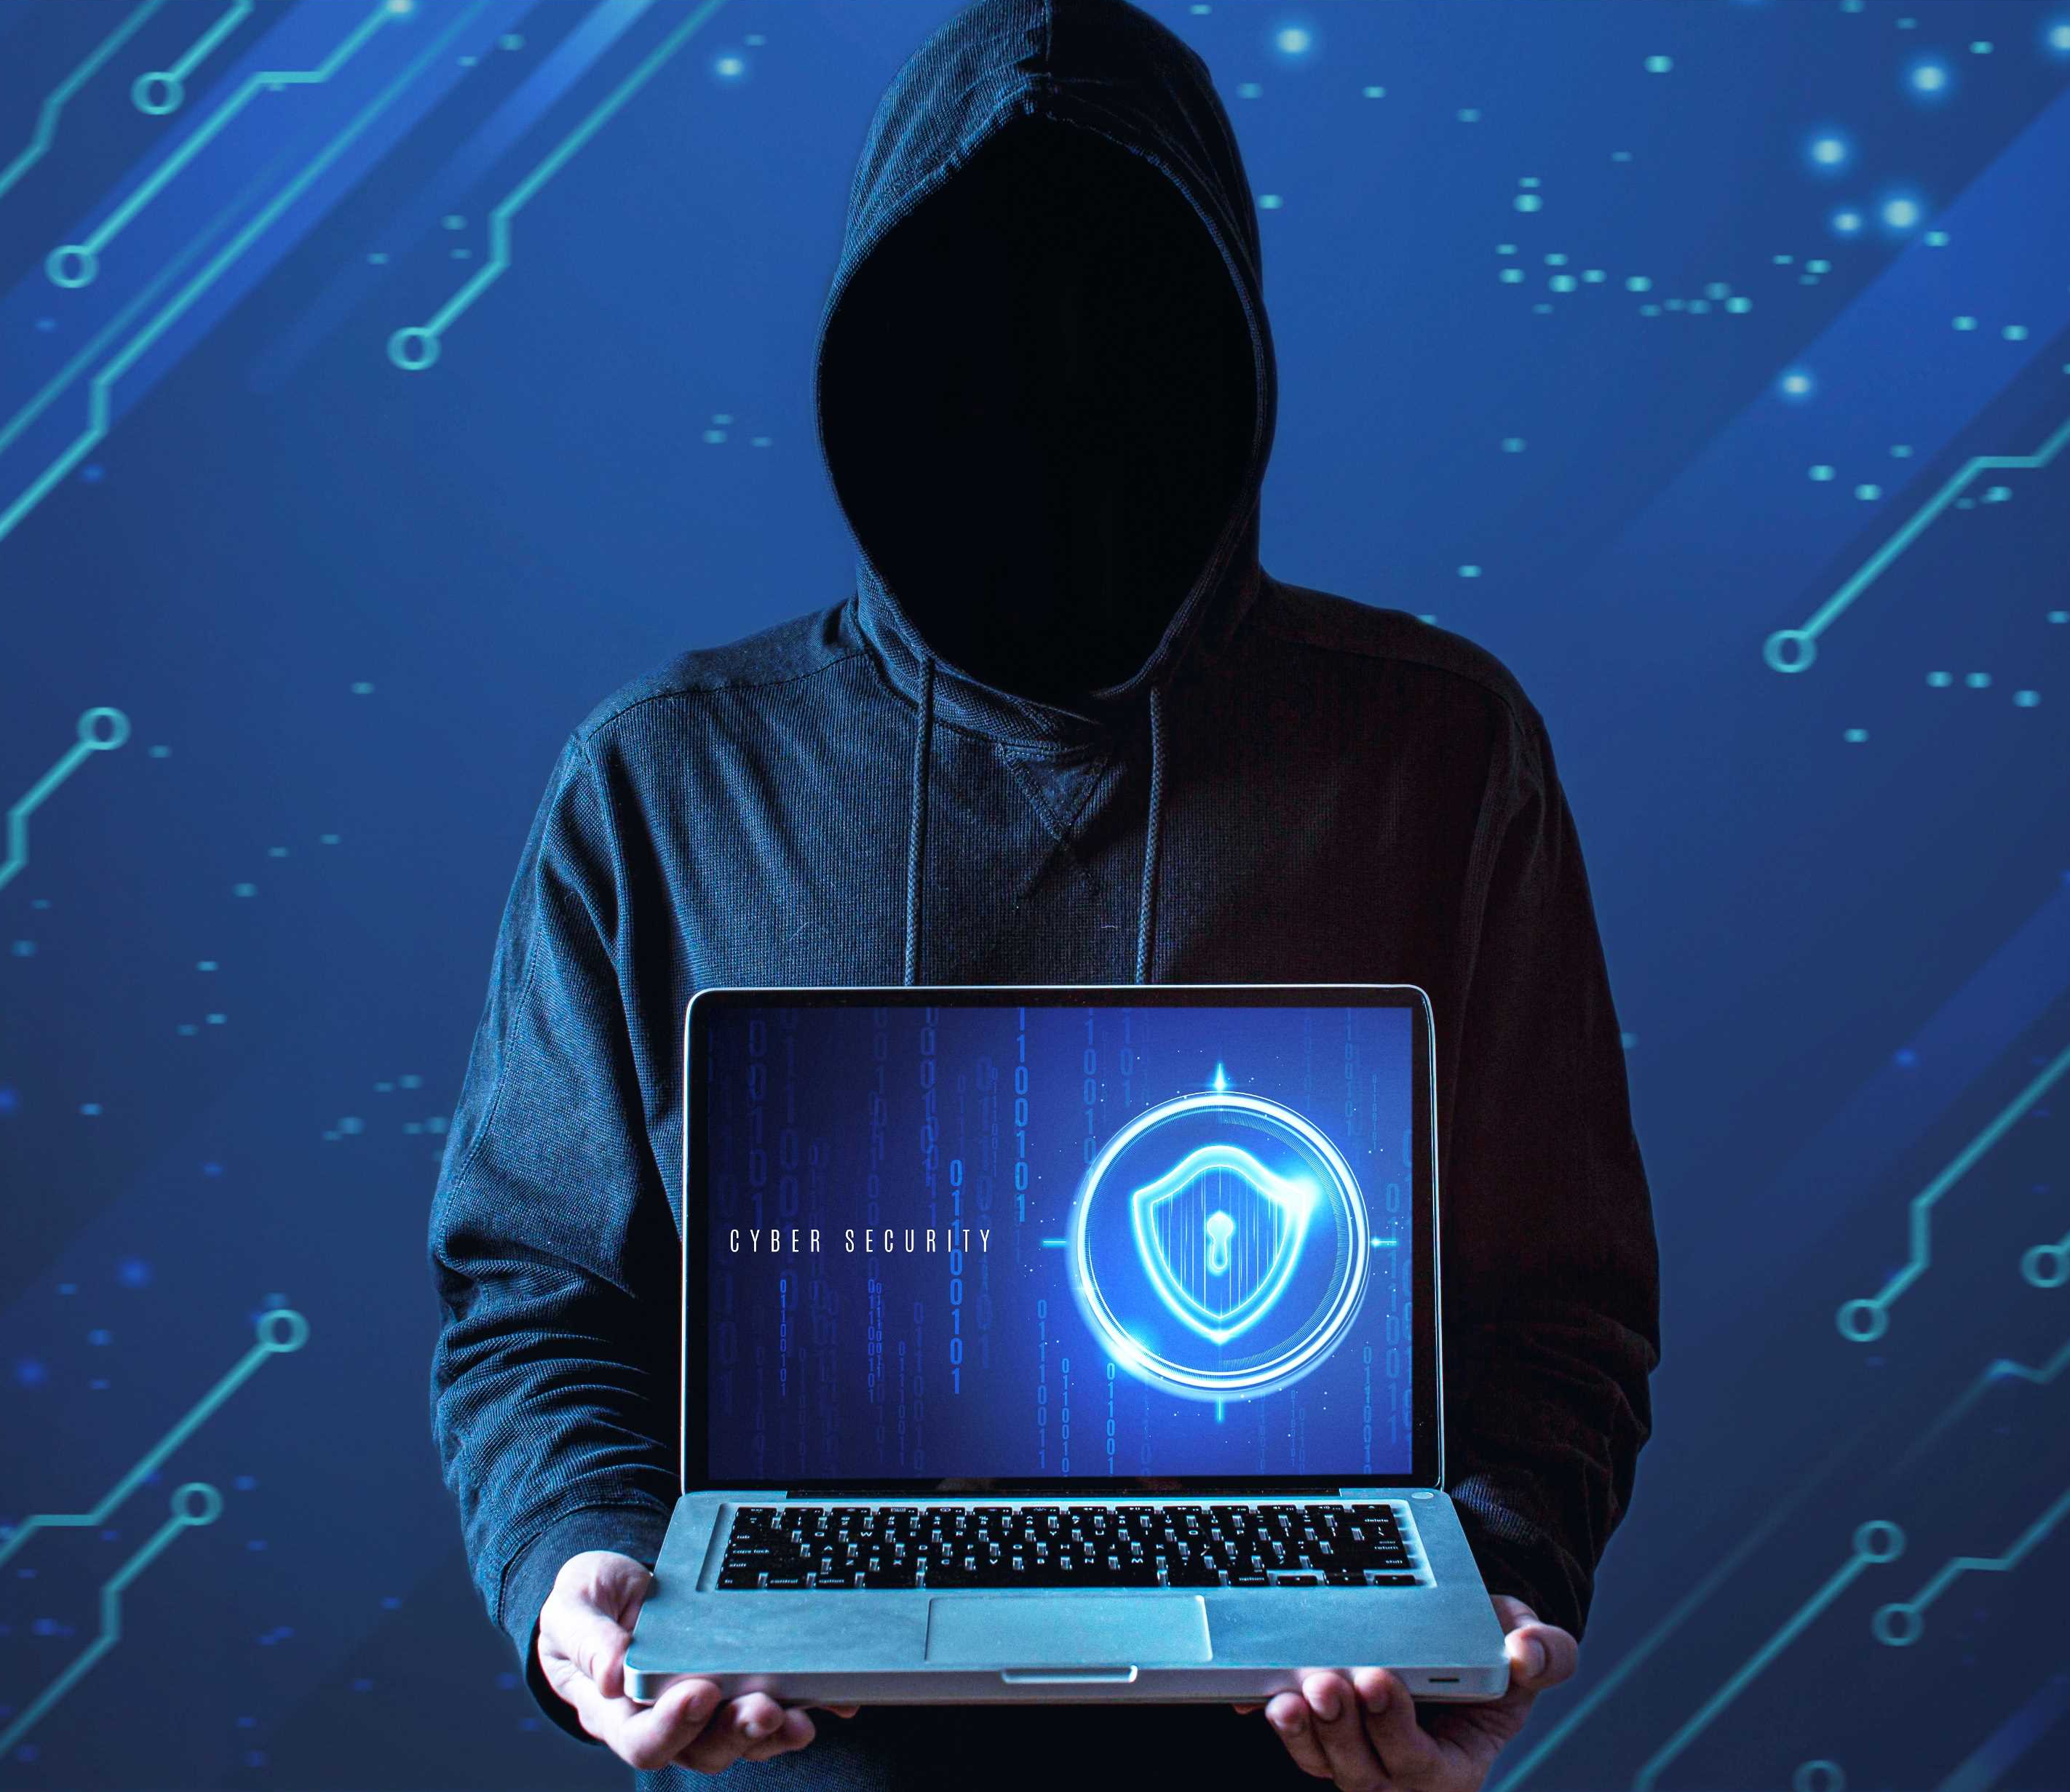
Phishing Awareness Training
Recognizing and Preventing Phishing Attacks
-BY DANGE SUNNY SHIVAJI
STUDENT ID :- CA/FE3/3156

Slide 2

Introduction
Phishing is a type of cyberattack where attackers impersonate legitimate organizations or individuals to deceive people into providing sensitive information, such as passwords, credit card numbers, or personal details. This is typically done through fraudulent emails, messages, or websites that appear trustworthy. It's important to recognize the signs of phishing attempts to protect yourself from falling victim to these scams. Keep an eye out for unusual sender addresses, poor grammar, and unexpected requests for sensitive information. Always verify the authenticity of any communication before responding or clicking on links..
PHISHING

Slide 3
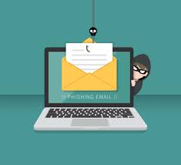
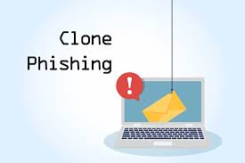
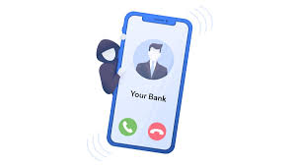
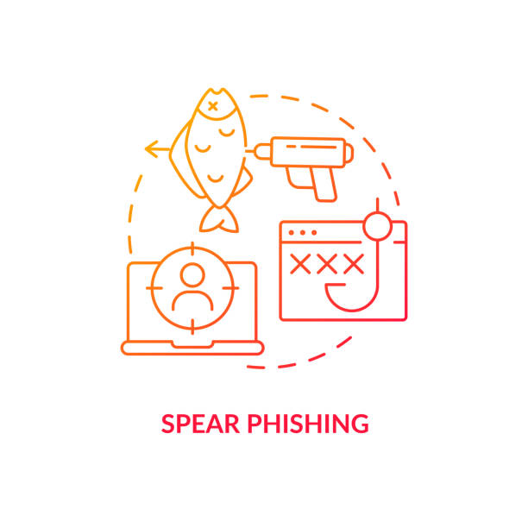
Types Of Phishing
Email Phishing
Clone Phishing
Vishing Phishing
Spear Phishing

Slide 4
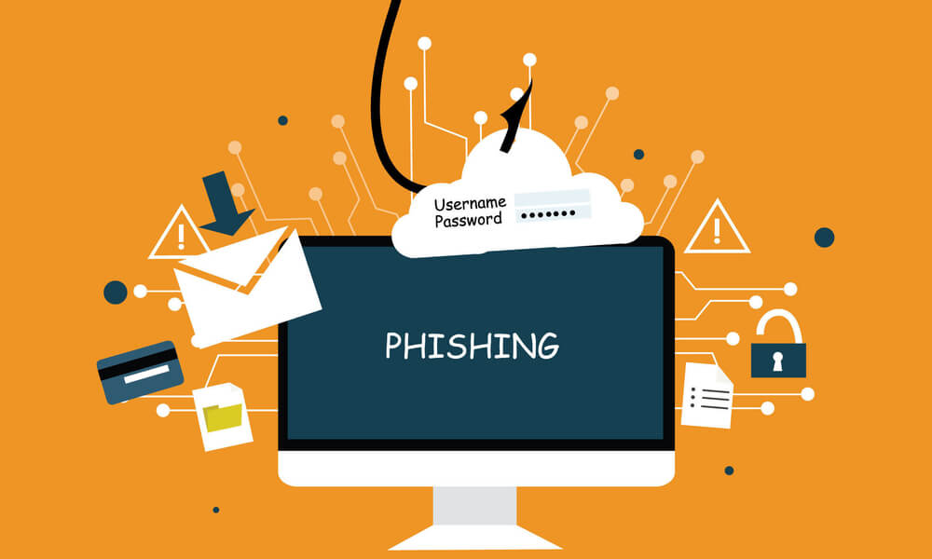
How Phishing Works
Phishing is a cyber scam where attackers trick people into revealing sensitive information like passwords, credit card details, or personal data. They often disguise themselves as trusted sources—like banks, social media, or company emails—to lure victims into clicking malicious links or downloading harmful files. Once someone falls for it, hackers can steal data, access accounts, or spread malware. Staying alert and double-checking links, email senders, and unexpected requests can help protect against phishing attacks.
PHISHING

Slide 5

Recognizing Phishing Emails
01
spelling errors
02
urgent language
03
suspicious links
03
Requests for Sensitive Info
PHISHING

Slide 6

Phishing Attack Lifecycle
1. Setup (fake website/email). 2. Lure (convince the victim). 3. Exploit (steal credentials). 4. Execution (use stolen data).

Slide 7
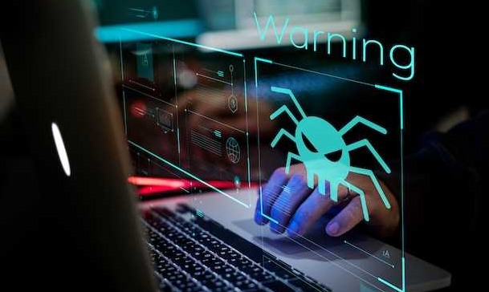
Real-World Phishing Cases
01
Google & Facebook scam ($100M loss)
02
Twitter employee hack
03
2016 DNC email breach.

Slide 8

Consequences of Phishing
Phishing can have serious consequences, both for individuals and organizations:
Financial Loss – Victims may lose money due to stolen bank details or fraudulent transactions.
Identity Theft – Attackers can use stolen personal information to commit fraud or open accounts in your name.
Data Breaches – Phishing can compromise sensitive company data, leading to leaks and security breaches.
Malware Infections – Clicking on malicious links or attachments can install ransomware, spyware, or viruses.
Reputation Damage – Businesses that fall victim may lose customer trust and face legal or regulatory penalties.

Slide 9
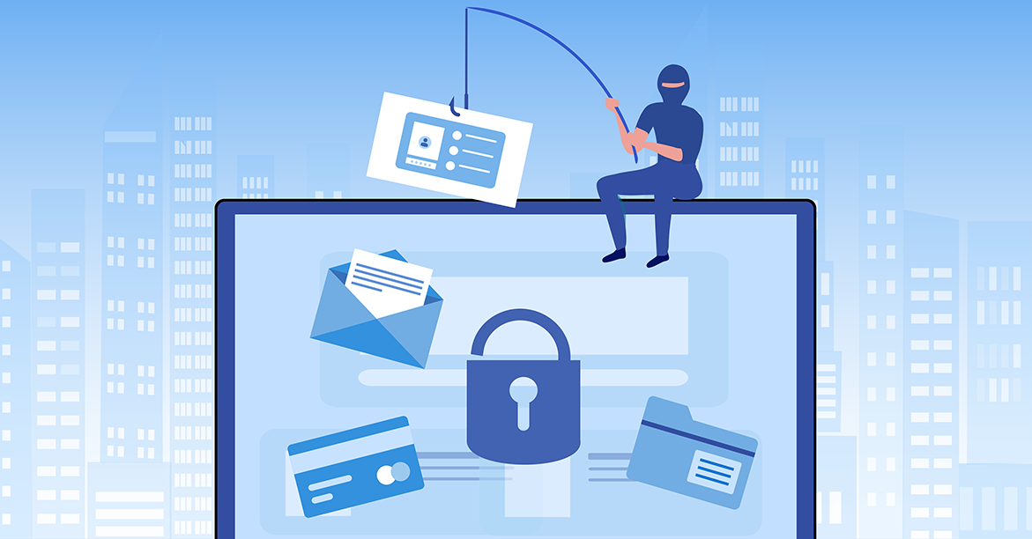

Advanced Phishing Techniques
1. AI-powered phishing. 2. QR code phishing 3. Deepfake social engineering.
PHISHING

Slide 10

Phishing Prevention Strategies
01
Use Multi-Factor Authentication
02
verify email links
Understand the risks associated with Phishing
03
train employees

Slide 11
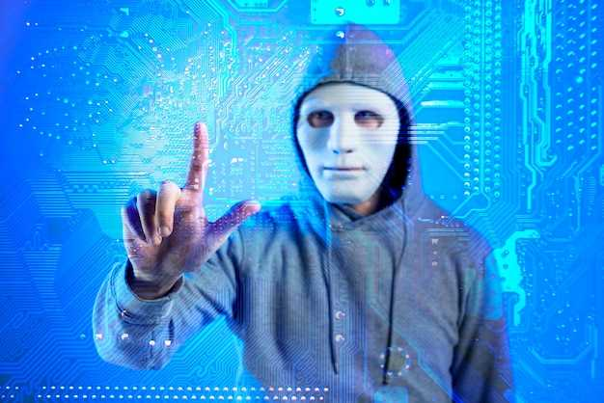
Understanding Phishing Tactics
01
Cybercriminals use trust manipulation
02
fake urgency
impersonates CEOs, CFOs, or other decision-makers to manipulate employees.
03
impersonate banks, government agencies, or IT support
04

Slide 12

Emotional Triggers in Phishing
Phishing attacks often exploit human emotions to manipulate victims into acting impulsively.
PHISHING

Slide 13
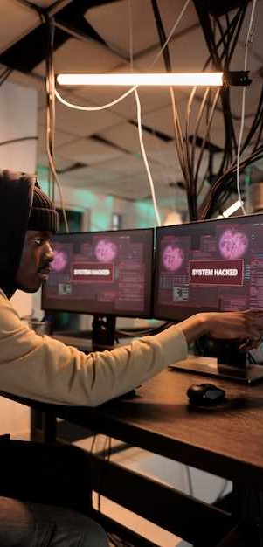
01
Reconnaissance
Step-by-Step Breakdown of a Phishing Attack
02
Delivery
03
Exploitation
03
Execution

Slide 14
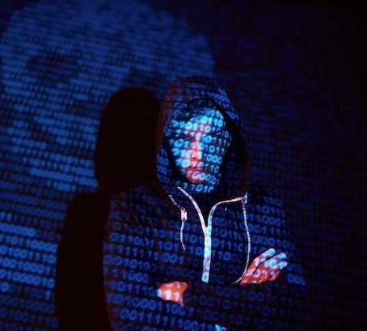

Spotting Fake Websites
Check for HTTPS, misspelled URLs, and suspicious design inconsistencies
PHISHING

Slide 15

Phishing via Social Media
Attackers use fake profiles, friend requests, and direct messages to lure victims.

Slide 16
Final Quiz & Recap
1.What emotions do phishing attacks exploit?
2. What are some indicators of a phishing email?
3. How can you spot a fake website?
4. What is the role of AI in modern phishing attacks?
5. What should you do if you suspect a phishing attempt?

Slide 17
Thank You!
We respect your valuable time

